Slide 1

Digitalization of Supply Chain
Global SC Analytics CoE - SCCORE

Slide 2
Agenda
Digitalization of Supply Chain - General Trends 5’
Focus on Advanced Analytics for SC Planning 25’
IBP
Statistical Forecast
E2E Visibility
Key Next Steps 10’
Open Discussion / Q&A 5’

Slide 3
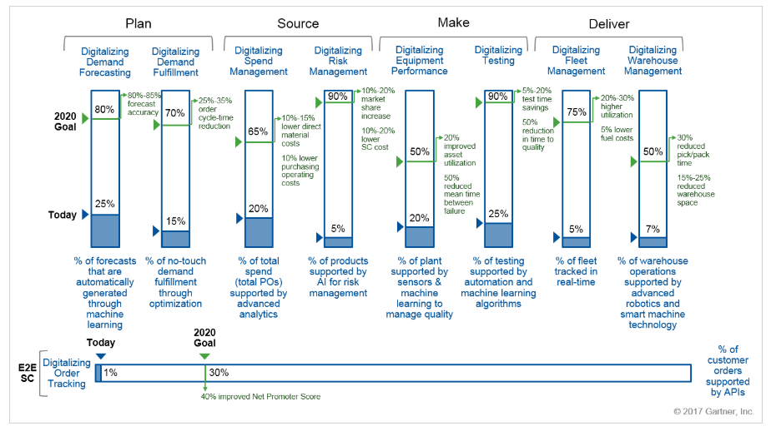
Goals, Benefits and Extent of Supply Chain Process Digitalization
SCCore mainly value driven with large focus on Planning Analytics (IBP, Forecast, Demand-Supply Planning, Inventory..)
But Supply Chain is as well investing in Customer Care (Order automation, EDI..) and Logistics (Track/Trace, Warehousing Automation..)

Slide 4
SC Planning is a key driver to Inventory Reduction, End to End visibility and Service Level improvement
3
KEY DRIVERS
MAIN CASH LEVERS
KEY CHANGES
Bridging Operational Performance to Value Case
986M€
Cash Levers
DEMAND
COMMERCIAL INV.
ONE BUSINESS PLAN
Better decision making through S&OP/IBP
Demand Valorization
What-if Scenarios (incl. Impact Assessment in $)
FINANCIAL DRIVEN ARBITRATION
Build Forecast & Improve MAPE
SUPPLY
INDUSTRIAL INV.
Advanced Analytics (Statistical Forecast)
Demand Sensing (Demand Value Driven SC)
FACT BASED DECISION MAKING
Inventory Optimization
Multi-level / Multi-Site Planning
Multi-echelon Inventory Policies
Optimized Lead Times
MID/LONG TERM STRATEGIC PLANNING
IBP
INTEGRATED
BUSINESS PLANNING
E2E Planning Visibility
On –line E2E Network Inventory Visibility
REAL TIME DATA & WHAT IF SCENARIO ANALYSIS
Real Time Demand propagation
Concurrent Planning
CASH Impact
4

Slide 5
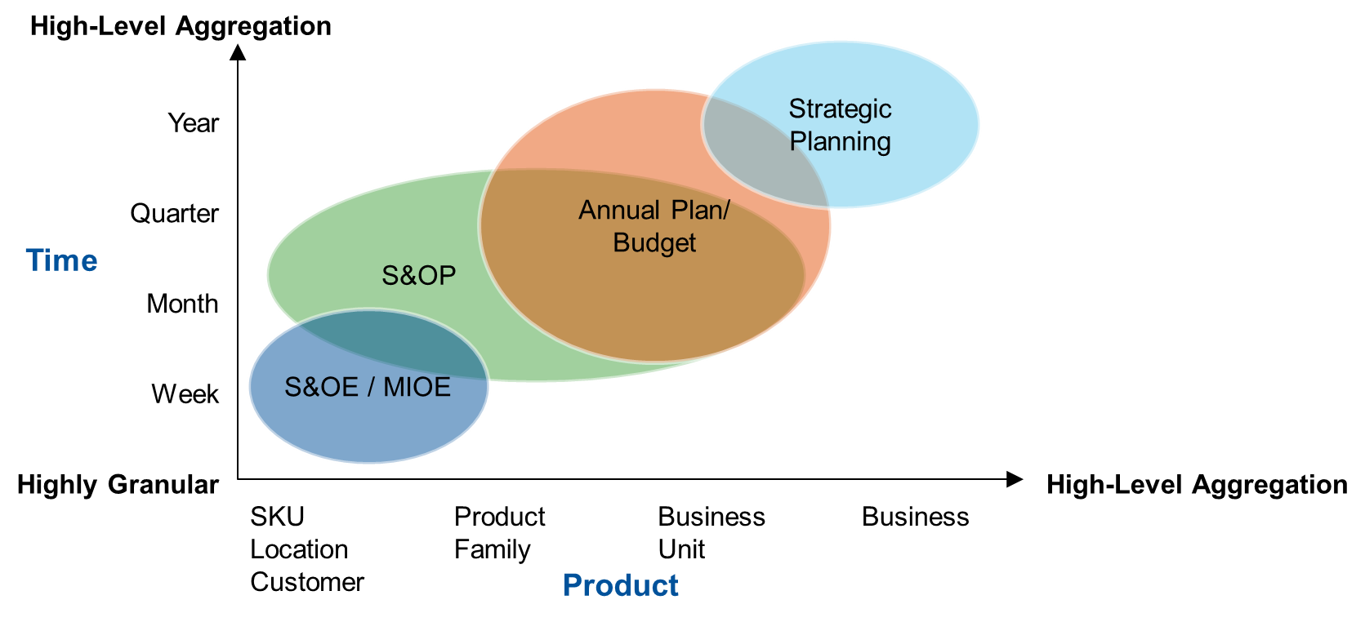
IBP Objectives & Outcomes
IBP is the platform to agree on an Integrated Plan between Commercial, Finance, Supply Chain/Industrial Affairs
Allow submission of the financial forecast (automated valorization of sales forecasts units -> value)
Provide an accurate demand plan to better secure drug supply to patients
Planning hierarchies

Slide 6
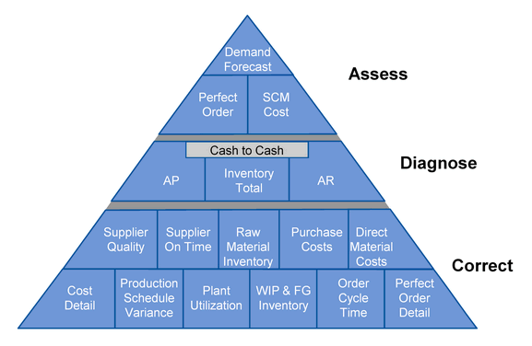
How Advanced Analytics will support IBP ?
‘What If’ Scenario giving global visibility for decision to be taken
in full transparency & trust into the organization
Sales visibility and projection on actuals and YTG, providing gap identification vs financial budget and supporting decision making
Real Price-Volume results & Gross-Margin projection showing impact on sales changes & better use product profitability
Real-Time capacity utilization projection supporting volume allocation, budget elaboration and investments decisions
E2E Inventory tracking, control and projection (units/conso CoGs) with managerial view
Single source of truth, no questioning numbers but looking for better outcomes aligned with company objectives
Notes:
Another key area to consider is the high-level impacts that the COE will target. While each project will have specific impacts attributed to its business case, there needs to be some outline for where the COE will target improvements in the supply chain.
While reviewing this, consider using the Gartner’s Hierarchy of Metrics (see The Hierarchy of Supply Chain Metrics: Diagnosing Your Supply Chain Health) as one way to frame the discussion.

Slide 7

Improved Demand Signals for One Business Plan
S&OP / IBP
Statistical Forecast
Unconstrained Demand Plan
Constrained Supply Plan
Optimal & unbiased baseline signal based on history data
Statistics or Machine Learning
S&OP Demand Review
IA constraints
Final Business Plan
Validation of the assumption by Finance & Management
Market Intelligence
Consensus Mkt./Commercial/Trade
S&OP Supply Review
”One Business Plan”
Risk and opportunities - simulation
Allocation scenario
Causal Factor
Market insight
S&OP Management review
History Cleansing
Constrained Demand Plan
Demand Review
Supply Review
Executive Review
Major steps supported by AI
Major improvements on Statistical Forecast + Causal Factor integration
Strengthening of Allocation scenario
Notes:
Example:
Clexane → from Unconstraint to Constraint
Depakine

Slide 8

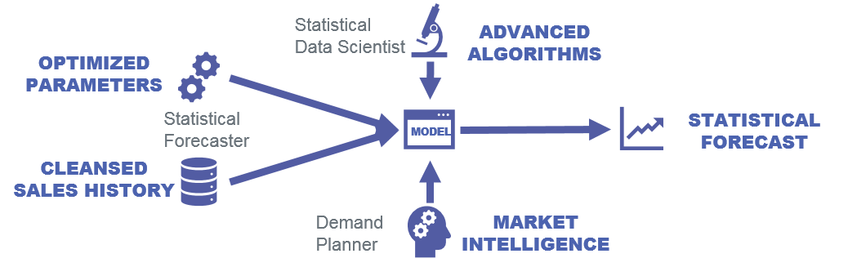
Professionalization of Forecasting
New Operating Model
Advanced Tools
Improve Forecast Performance
36-month horizon
Sales Out
Sales In
signed SLA
Segmented Portfolio
Aggregated TOTAL MAPE Change
Achievements
50
Total.MAPE
CoV
Before.Total 34.4
After.Total 14.8
40
MAPE improvement : gain of 19.6pp (- 43% of error)
Results from International region
16 Markets included represent 35% of the volume and 24.5% of the value
30
19.6pp
%
20
10
0
-24
-21
-18
-15
-12
-9
-7
-5
-3
-1
1
3
5
7
9
11
13
15
17
19
21
23
M

Slide 9
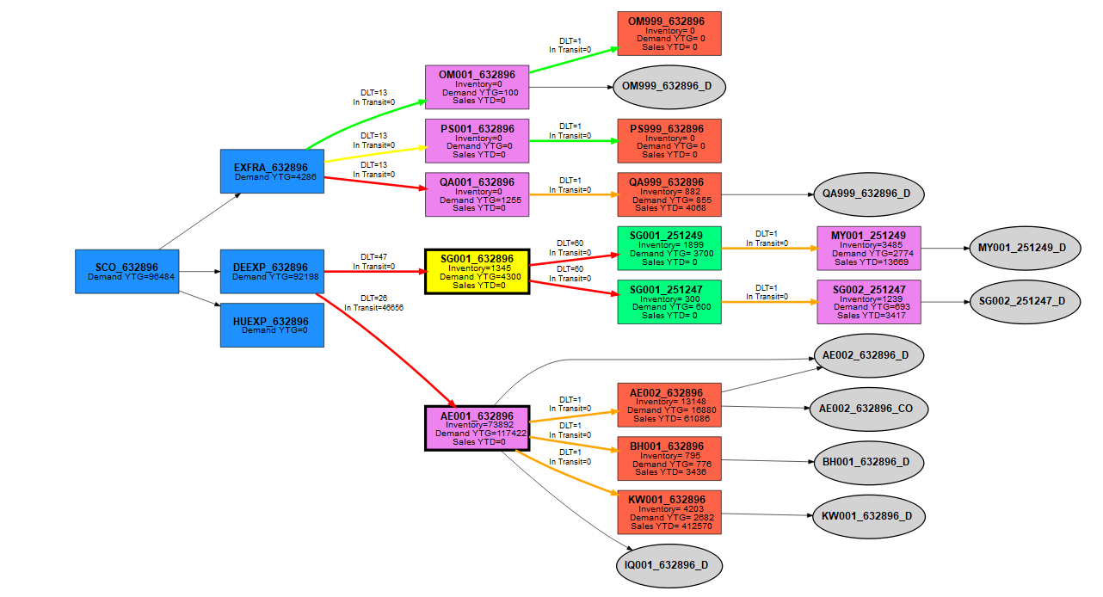
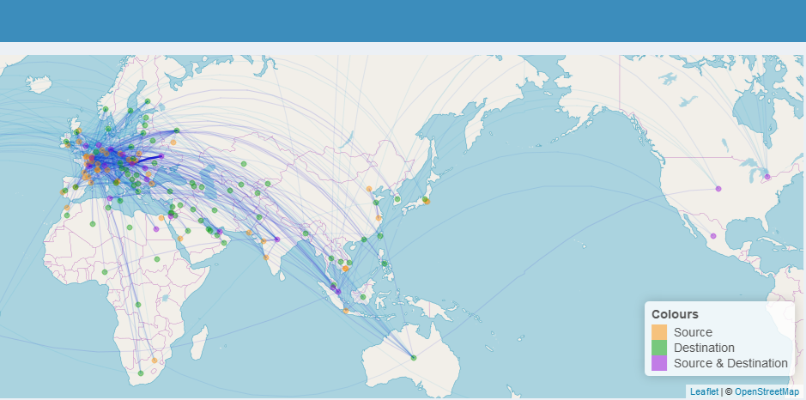
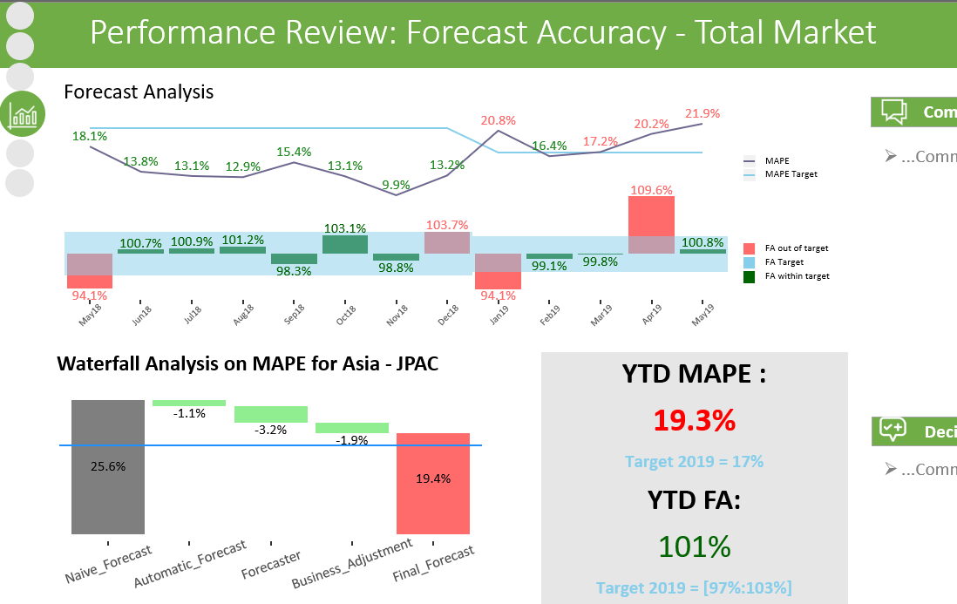
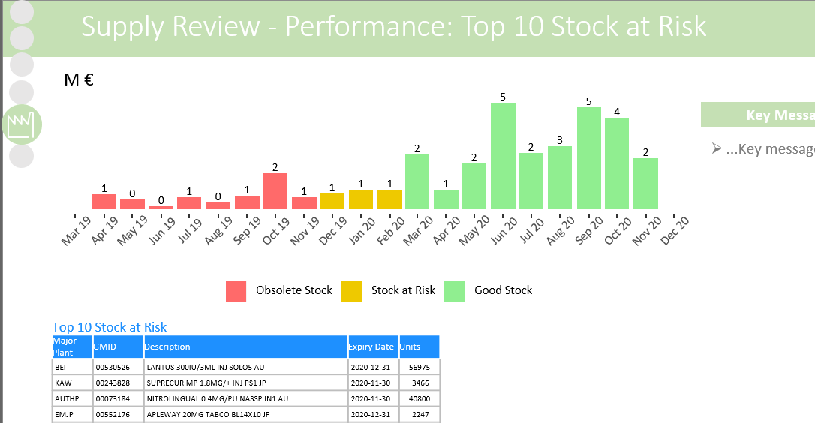
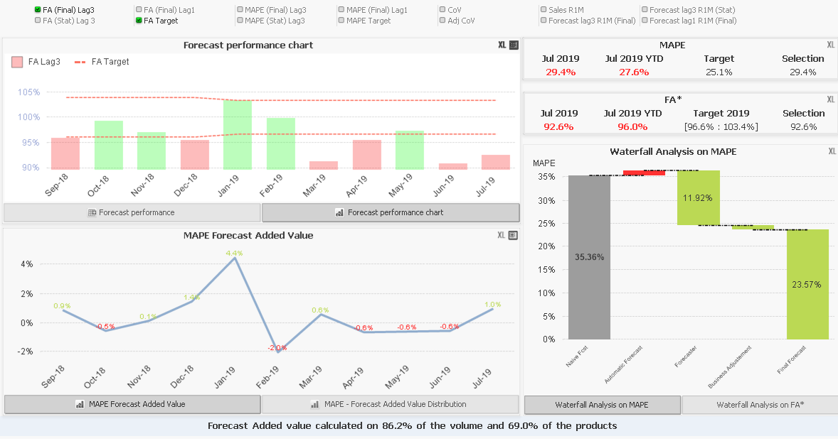
GLOBAL VISIBILITY, TRANSPARENCY & TRUST …. FROM SINGLE SOURCE
Interactive Automated Dashboards
SC Modeling Visualization
EURO sales
Visibility on Sales projection
Comparison to Financial target
Visibility on Breathing space
Price Volume effect
Real time visibility on Price-volume effect
Standard report
Quantity sales
Gross Margin
Real time visibility on Gross Margin projection vs latest FC
Understand P&L impact of Volume & Price variation
Real time Capacity Management projection based on latest FC
Investment decision / Volume allocation & Budget
Capacity Mgnt
Supply Chain Diagram by Products
S&OP Performance review
S&OP Supply review
Market SC Dashboard
Supply Chain Flow over the world

Slide 10














Key Applications on Statistical Forecasting/ Advanced Analytics
Today
Tomorrow
Beyond
Deploying
Boosting 1- 2 years
Future 5 years…
Stat. Model Optimization
Advanced Fcst Algorithm
Advanced Visualization
Data Science
Parameter Fine Tuning
Optimum Model Selection
Ensemble Learning Model
Parallel Processing
Risk factorization in Forecast
Broader Internal/External Data integration
Life Cycle Forecasting
Daily Sales Profiling
Product Characteristics Clustering
Recurrent Neural Network Algorithm Implementation
Feature Engineering
Latest Research Monitoring
14 Forecast Algorithms
Advanced Visualization
Data Science
Automated Reporting
E2E Planning Dashboard
Alert & Monitoring
Forecast Heatmap App
SC Network Map & Diagram App
AI Conversational Dashboard
E2E Supply Chain Modeling
E2E SC Reporting
Actionable recommendations
Impact Quantification/Valorization
Forecast Target Determination
MasterData Anomaly identification
Potential Gain Classification
Multi Echelon Inventory Optimization (MEIO)
Supply Chain Network Design
Milk Run Optimization
Allocation of Scarce resources
Self Healing
Prescriptive Supply
IoT Sensor Network
E2E SC Digital twin for simulation
Predictive Analytics
Prescriptive Analytics
Fully Deployed
GLPK / GMPL
Still to be discovered…

Slide 11
How to further combine efforts ?
Mutual sponsorship Finance and Supply Chain to promote IBP
Toward “One Business Plan”
Promote Sanofi P&L
Cross functional set of KPIs linked to Net sales, P&L & Balance sheet
Further enhance collaboration between both functions on Analytics :
Global SC Analytics CoE and Global Finance Analytics CoE : “One Source of Truth”
Initiatives on Forecast
Alignment on Industrial Capacity

Slide 12
Appendix

Slide 13

E2E Connected and Coherent set of KPIs to monitor the performance of Supply Chain Planning while understanding their impact on Sanofi’s P&L and Balance Sheet
ACCURACY
RCA (*)
MAPE / SPA
ND VARIABILITY
‘Noise from the Market to the Plant’
SUPPLY BIAS
‘Plant Production plan vs the Net Demand’
NET DEMAND VARIABILITY
OPERATIONAL
MAPE / SPA
MPS
‘Plant Scheduling adherence’
SUPPLY BIAS
LEAD TIME ACCURACY
STRATEGIC
Top Line Sales (P&L)
Net Sales
SERVICE
SERVICE
CLIENT
MARKET
EXPORT DC
PLANTS
Pharma
PLANTS
Chemical
SUPPLIER
CSL
OTIF
CSL
OTIF
NET DEMAND FULLFILMENT
CSL
Interim Solution
MtO:
MtS:
OTIF
CSL_{2.0} (CRP)
OTIF
ISL (VMI)
ND FULLFILMENT
‘Service provided by comparing
shipments vs the Net Demand’
MtO:
MtS:
OTIF
CSL_{2.0} (VMI)
ISL
Bottom Line (P&L)
COGs
SERVICE OOB
Below min / Above max agreed
SERVICE OUT OF BOUNDARIES
DESTRUCTION
DEST. COSTS
E2E Destruction Costs
AGING & SLOW MOVERS
Stock with potential issues related to Shelf Life & Slow Movers
DESTRUCTION
MANAGERIAL
DESTRUCTION COSTS
Balance Sheet
COGs
INVENTORY
AGING & SLOW MOVERS
INV. COVERAGE (DIO & DOS)
Backward & Forward Looking Coverage
INVENTORY
E2E
DIO & DOS
E2E
VALUE
INVENTORY VALUE
Accountability per node
INV. COVERAGE (DIO & DOS)
E2E Managerial Accountability
INVENTORY
VALUE
Weighted by Net Revenues & COGS & Units
(Finish Goods)
Weighted by COGS & Units
(Non Finish Goods)
(*) RCA: Root Cause Analysis

Slide 14
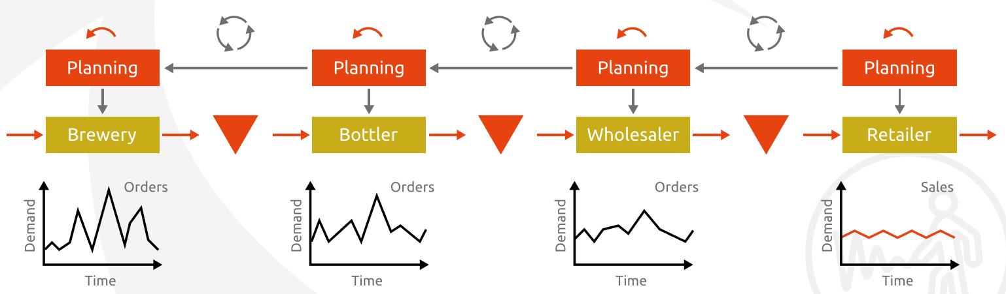
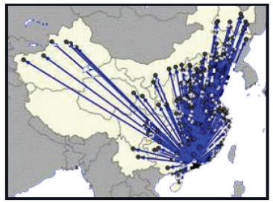
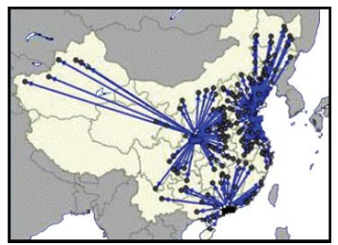
Simulation & Optimization example:
Multi echelon Inventory optimization
Due to Supply Chain complexity, usual operational optimization tend not to work and cannot cope with stochastic demand. Simulation with discrete events allows to model the supply chain and simulate multiple times (x1000, x10000…) the customer service using different inventory level at each echelon.
Facilities location
Use of Optimization to determine the optimum number of warehouses needed and customer allocation by warehouses

Slide 15
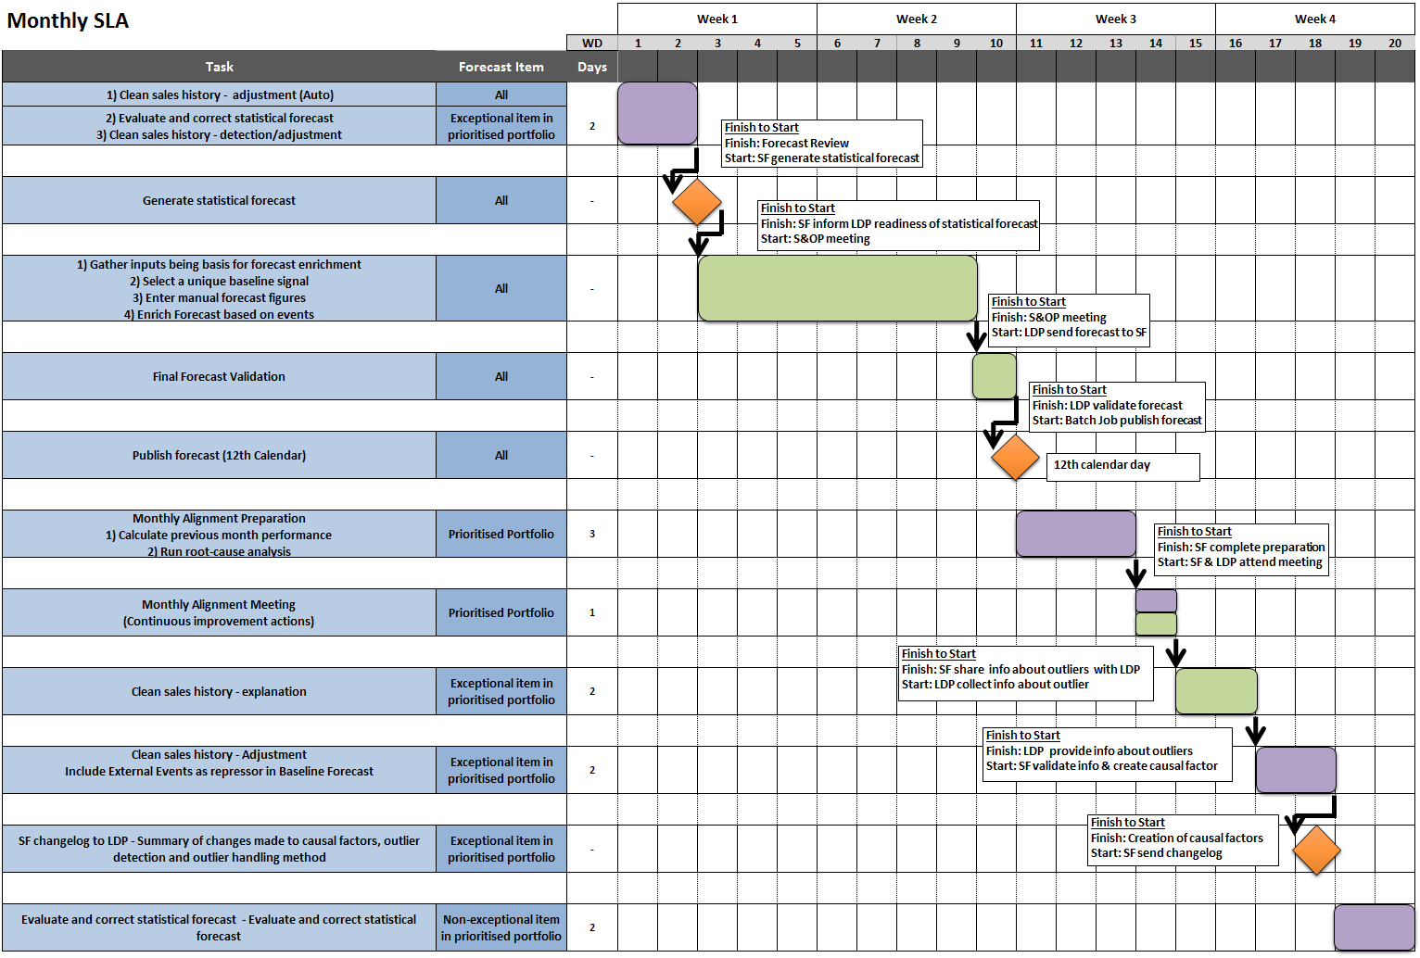
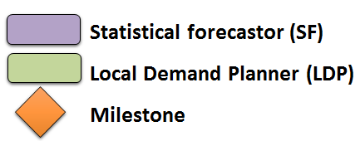
Appendix- Statistical Forecasting Monthly SLA - Committed timelines

Slide 16
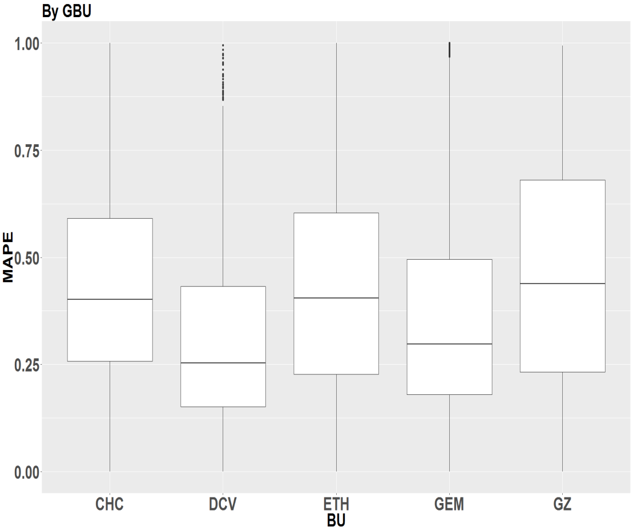
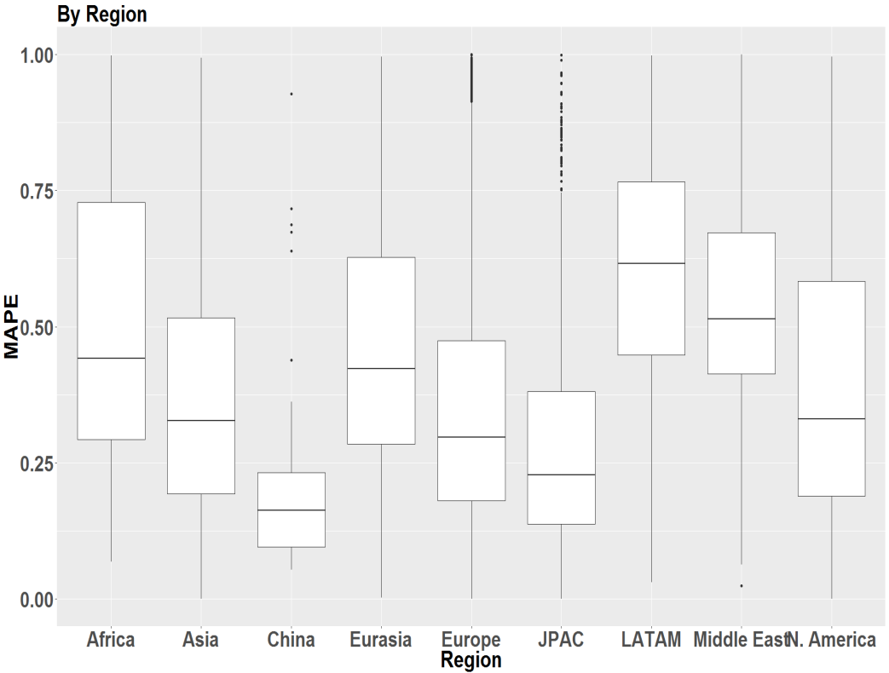
Boxplot by grouping
Compare the MAPE between regions vs MAPE between GBU to determine which grouping shows greater variation
By region grouping shows greater variation in both mean and the Interquartile range (IQR)

Slide 17
SC Planning accelerated Plan: Pharma & Vaccines Inventory
CASH Impact
986M€
An additional +30% cash impact in 2020 while offsetting
Shift impact, compared to the Original VC
Bringing down to 3,2Y program Payback
961M€
833M€
-0M€
+25M€
647M€
502M€
-36M€
+222M€
434M€
-37M€
+106M€
177M€
639M€
664M€
126M€
637M€
5,5M€
18M€
601M€
432M€
500M€
-0M€
+13M€
-80M€
+131M€
1,7M€
195M€
322M€
322M€
1,7M€
46M€
2019
2020
2021
2022
2023
PLANTS
INVENTORY
2,6%
13,7%
41,9%
75,3%
91%
95,3%
98,2%
99%
99,3%
99,8%
MARKETS
NET SALES
13,5%
10,6%
63,6%
51,1%
89,3%
99,3%
96,9%
99,7%
98,5%
100%
VCx
INVENTORY
0%
0%
0%
0%
4%
3%
100%
100%
100%
100%
Shift Impact
Deploy & Sccope Acceleration
17
Pharma Inventory
Vaccines Inventory

Slide 18
SC Planning accelerated Plan: Pharma Inventory
CASH Impact
PRE-REQUISITES
RISKS / CONSTRAINTS
Enable external hiring for key ITS positions in SCCORE
Additional resources for Sanofi
(+5 FTEs ITS + 7 FTEs BZ)
Frankfurt (P08) Standalone connection
Athena to be implemented
(in Oracle sites by Oct 2020 & Köln by Jan 2021)
Build interfaces with Legacy Back Office
(P08, CEP, Unity, SAP LATAM, SAP Brazil)
SCCope wave 1 & 2
(pooling of plant SC)
Legacy Platform upgrade Strategy not aligned with SCCORE Roadmap
Resource Management / Capability at legacy Platform
637M€
500M€
601M€
432M€
-15M€
+51M€
177M€
-37M€
+106M€
126M€
5,5M€
18M€
-0M€
+13M€
-80M€
+131M€
2019
2020
2021
2022
PLANTS
INVENTORY
2,6%
13,7%
41,9%
75,3%
91%
95,3%
98,2%
99%
MARKETS
NET SALES
13,5%
10,6%
63,6%
51,1%
89,3%
99,3%
96,9%
99,7%
Shift Impact
Deploy & Sccope Acceleration
Pharma Inventory
Vaccines Inventory
18

Slide 19
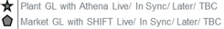
SC Planning accelerated Plan: Vaccines Inventory (work in progress)
CASH Impact
PRE-REQUISITES
RISKS / CONSTRAINTS
Enable external hiring for key position in SCCORE
Additional resources for Sanofi
(+5 FTEs ITS + 5 FTEs BZ)
Build interfaces with Legacy Back Office
(IS200)
IS2000 Complexity landscape
(4 platforms)
Resource Management / Capability at legacy Platform
Kinaxis Functionality readiness for Vaccines by March 2020 (Attribute Based Planning)
Legacy Platform Connection ready by Q2 2020
Big Bang Go-Live approach : Q1 2021 (5 sites)
322M€
322M€
Markets
Go-Live
-0M€
+0M€
HOW TO ACCELERATE FURTHER ?
Fund & Start NOW IS2000 interface build
Additional resources immediate staffing
Release resource availability of IS 2000 teams
196M€
Plants
Go-Live
46M€
+21M€
+171M€
0M€
0M€
0M€
0M€
1,7M€
1,7M€
2019
2020
2021
2022
2023
VCx
INVENTORY
0%
0%
0%
0%
4%
3%
100%
100%
100%
100%
Shift Impact
Deploy & Sccope Acceleration
Pharma Inventory
Vaccines Inventory
19

